Slide 1
LAN Cabling

Slide 2
Implementing
UTP

Slide 3
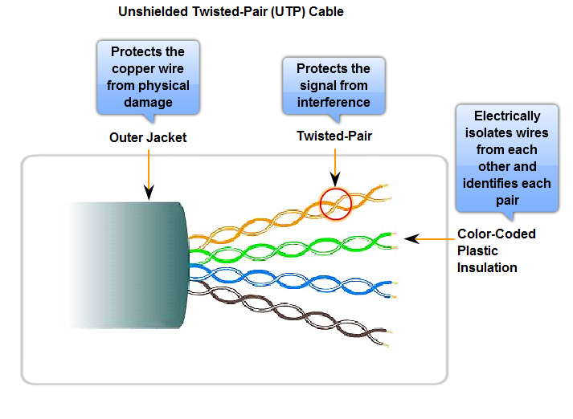
Unshielded Twisted Pair (Pair)

Slide 4
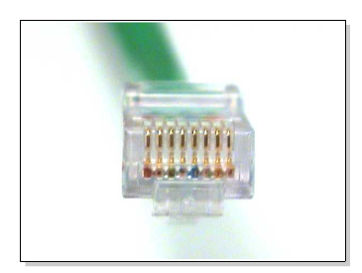
RJ-45 Connector

Slide 5
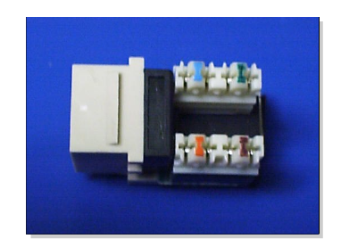
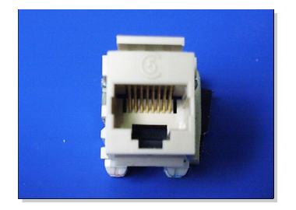
RJ-45 Jack
Front View
Top down View

Slide 6
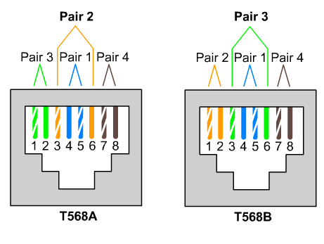
T568A and T568B Color Code

Slide 7
Cabling Instruction
Determine the EIA/TIA category of cable
  Use the documentation of the device
  Look for a label on the device near the jack.
  Otherwise use Category 5E or greater
Determine the type of Connection
  Straight Through
  Crossover
Make proper connection following color code (TIA568A or TIA568B)
Notes:
. Telecommunications Industry Association (TIA) and Electronic Industries Alliance (EIA)
Ethernet technologies can be used in a campus network in several different ways:
10 Mbps at the user level to provide good performance.
100 Mbps for clients or servers that require more bandwidth.
Fast or Gigabit Ethernet between backbone devices.

Slide 8
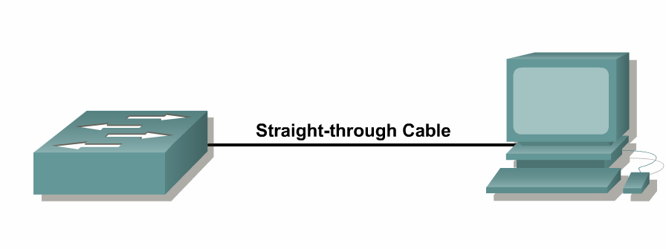
Straight-through Cable
Connects different layer devices
  Switch to router
  Switch to PC or server
  Hub to PC or server
Orders of colored wires are same at each end of connection

Slide 9
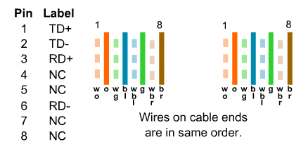
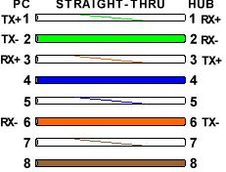
Straight-through Cable

Slide 10
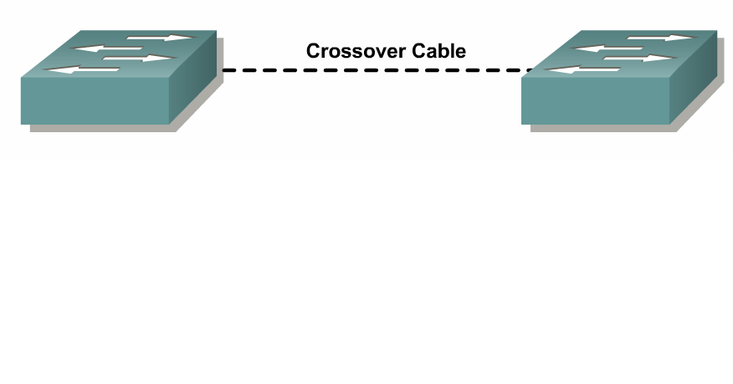
Crossover Cable
Connects Similar Devices
  Switch to switch
  Switch to hub
  Hub to hub
  Router to router
  PC to PC
  Router to PC

Slide 11
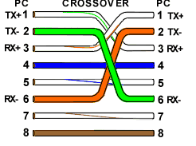
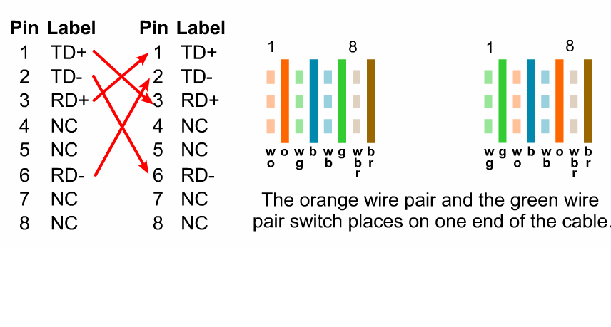
Crossover Cable

Slide 12
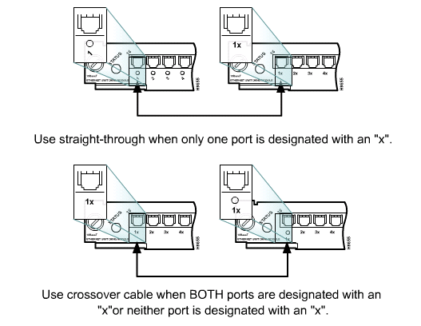
Connecting Cisco Devices

Slide 13
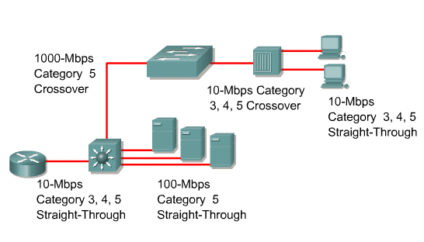
Interconnecting Devices

